Slide 1
Triple Your Membership in 21 Days… …and Do It Over and Over Again

Slide 2

Where are you from?

Slide 3
Triple Your Membership in 21 Days… …and Do It Over and Over Again

Slide 4

This Is For You If You Are…
…A Membership Business Owner/Leader -- Have a membership business
…Frustrated with a stagnant membership -- Want to grow your members with members who stick
…Tired of losing more members and money than you’re getting every month -- want to attract new leads that become cash-paying members quickly and easily

Slide 5

Imagine If You Woke Up Tomorrow and…
…And the number of new members you had last week, you’re now getting in just one day.
…Your retention rate jumped over 90%.
…The amount of revenue you did in last month, you’re now doing in one just one week!

Slide 6
It’s not your fault!
No one has shown you how to make your membership double or triple using one simple strategy
Until TODAY…

Slide 7


Why should you listen to this guy?

Slide 8
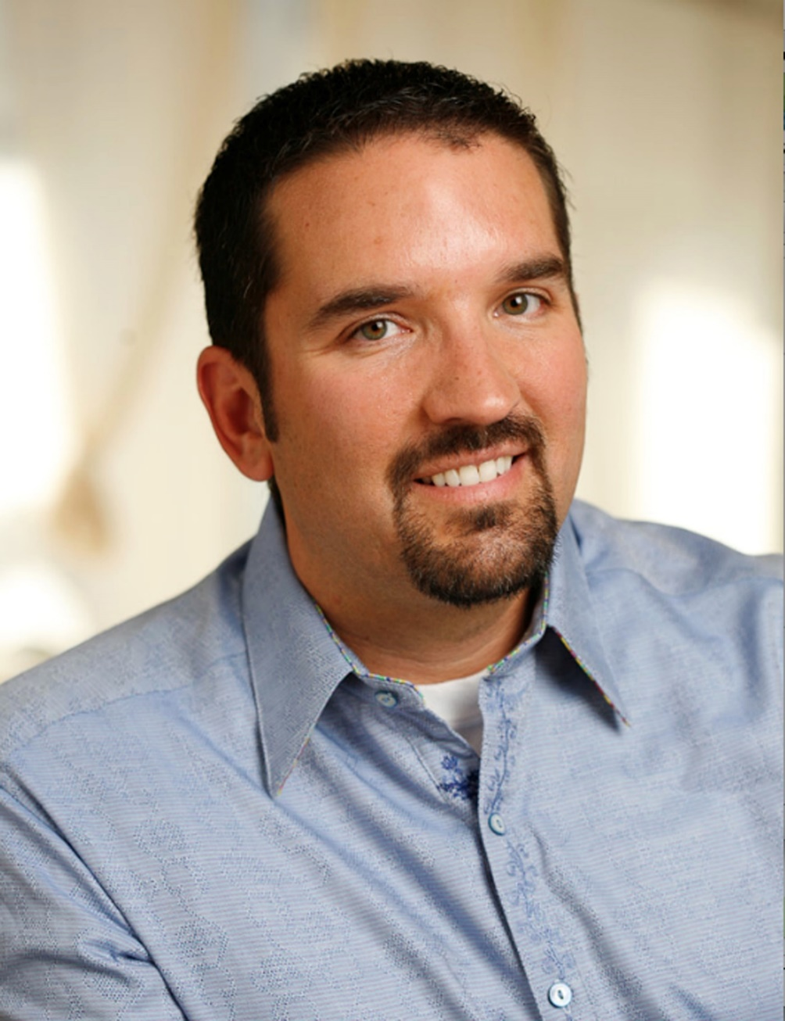
My first Multi-Million Dollar membership business
It’s not an exaggeration to say that this membership wouldn’t exist without Scott Whitaker.
After hearing me say for years that I wanted to build a membership for pastors, he finally cornered me (literally) in a hotel and told me it was time to put action behind my words.
Within two months, we had over 500 new members and added half a million dollars in revenue!
Nelson Searcy,
Coaching Member

Slide 9

From 72 Members
to 350 Members!

Slide 10

Something Had To Change
Stagnant
Disengaged
Losing Money!

Slide 11

There had to be a better way!

Slide 12


Slide 13
+
To
From
X

Slide 14

Over 350 members

Slide 15

Over 3,127 members

Slide 16

From $600,000 to
Over $4,000,000!

Slide 17

My membership is DIFFERENT!

Slide 18

Living on less than $35,000 per year!

Slide 19

Why am I teaching you this…
Stop the cycle of STRESS to MESS!
Experience financial freedom!
Help more people!

Slide 20

What you’re going to discover today
The Single Most Effective Tool to Triple Your Membership
How to Turn Prospects Into “Sign-Ups” for Your Membership
How to Move Members from Sign Up to “Fully-Engaged Members” (so that they stay for the long-haul!)
“I’m all in!”
Notes:
Type in the chat box – I’m all in!

Slide 21
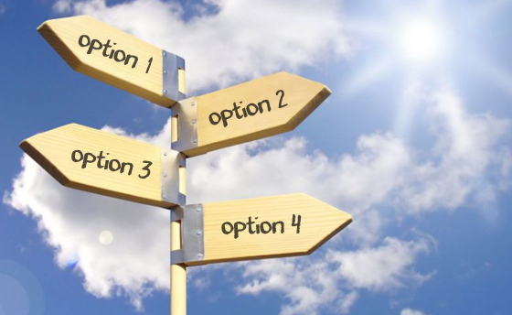
The Single Most Effective Tool to Triple Your Membership:
“The Trial Membership”
Most people just take a “BIG NET” approach to getting members.
When you do this, you spend money on marketing that doesn’t work.
When you spend money on marketing that doesn’t work, eventually you’ll go broke!

Slide 22
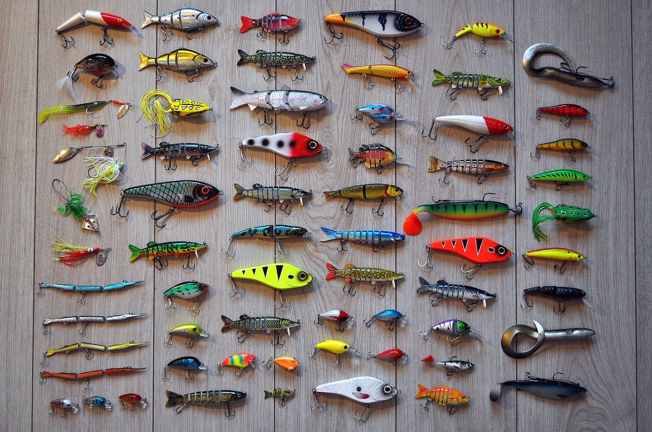
Lessons from a fisherman!
There’s a right time to use a net and there’s a right time to use a bait and hook.
When you use the bait and hook, you have to fish in the right water.
When you fish in the right water, you have go for the right kind of fish.

Slide 23

What you need to do…
Customize that Trial Membership to your specific prospects.
Create a “Trial Membership” that enables prospects to get a taste test of your membership.
You have to use the right bait to get them (and I can show you how!)

Slide 24

“I need your help!”
Created a membership but people weren’t taking it!
Lost thousands of dollars!
“Name your price!”
Bill Heid,
President Heirloom Audio

Slide 25
“I need your help!”
Created a “Trial Membership” knowing what his prospects would take it.
Customized the trial membership to give his new members the best experience.
Bill Heid,
President Heirloom Audio

Slide 26
“I need your help!”
“In just 24 hours our membership conversions went from 14% to 71% with one simple tweak that we discovered from Scott.”
Update: Months later we have over 91% retention
Bill Heid,
President Heirloom Audio

Slide 27

Turn prospects into sign-ups
Most people offer one way to sign-up
"No” doesn’t always mean “No”
You need to have an intentional step-by-step process (don’t leave it to “chance!”)

Slide 28

A time I was told “No!”
Stacy had “six businesses” she was running.
Wasn’t sure how she could create recurring revenue out of her business
Wanted to quit, but I was able to get her to upgrade her membership!

Slide 29

What you need to do…
Be prepared for when people say “No” and have another opportunity for them to say “Yes!”
When you have multiple choices, you have multiple streams of revenue.
The right pricing strategy builds a profitable membership business.

Slide 30
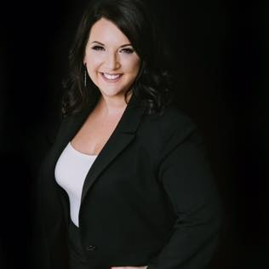
In just 30 minutes…
“In just the first 30 minutes of going through Scott’s program, we were able to multiply our membership revenue path more than 300%!”
Kim Walsh Phillips,
Powerful Professionals
& Private Client

Slide 31

Move your members from sign-up to fully-engaged
When someone joins your membership, you think they’re a member – they don’t!
If you don’t get people to engage their membership, they’re more likely to quit!
You won’t be able to help your members, like you promised!

Slide 32
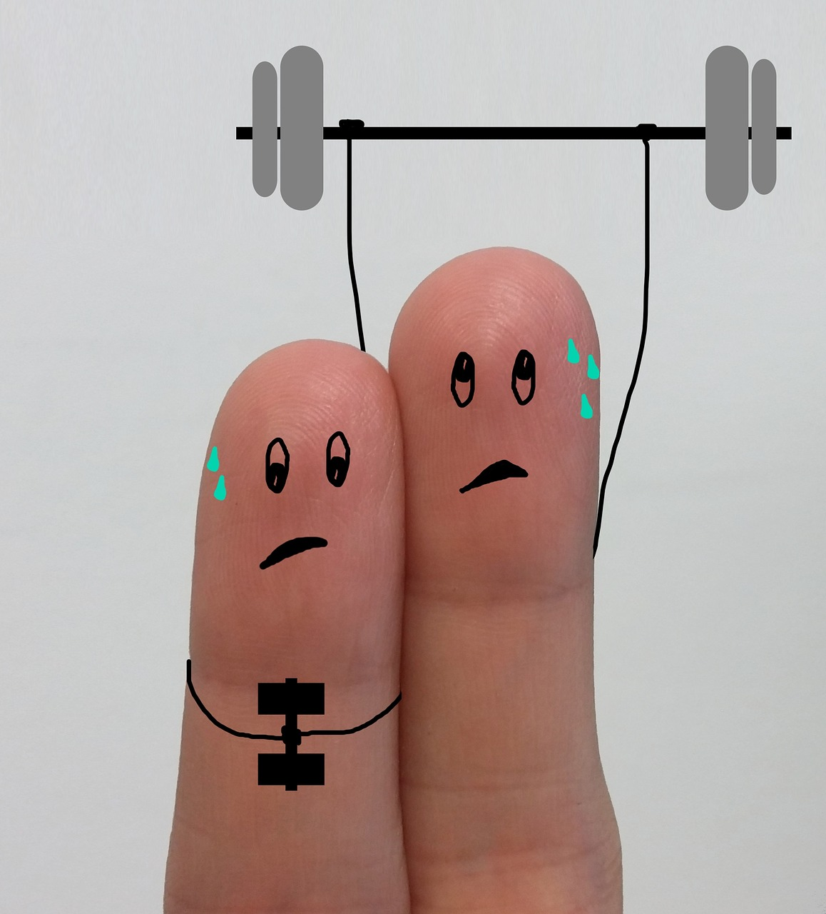
The time I Joined a Gym!
It took them 57 days to respond to my membership!
They immediately tried to upsell me (instead of showing me around the gym.)
They were intentional about their sales process but not intentional about their membership process.

Slide 33

What you need to do…
Know exactly what you want your members to RECEIVE!
Give your members a “quick win” that will make your membership – their membership!
Answer this question: “What do you want members to do in the first day of their membership?”

Slide 34

A 7+ Figure Sale…
“Because of Scott’s program, we were able to sell our membership company, Hudson Inc, for more than 7 figures.
I now “work” only three days a week, as I continue to profit from the business.”
Adams Hudson,
Founder of Hudson Ink
& Private Client

Slide 35
So far you’ve discovered
How to create a trial membership that attracts new prospects.
How to take those prospects and actually get them to sign-up for your membership.
Move people from “your membership” to “my membership” and get them fully-engaged!

Slide 36

How Do I Multiply My Membership?

Slide 37

You Have Two Choices…
Trial and Error
Implement a proven process and get results quickly

Slide 38
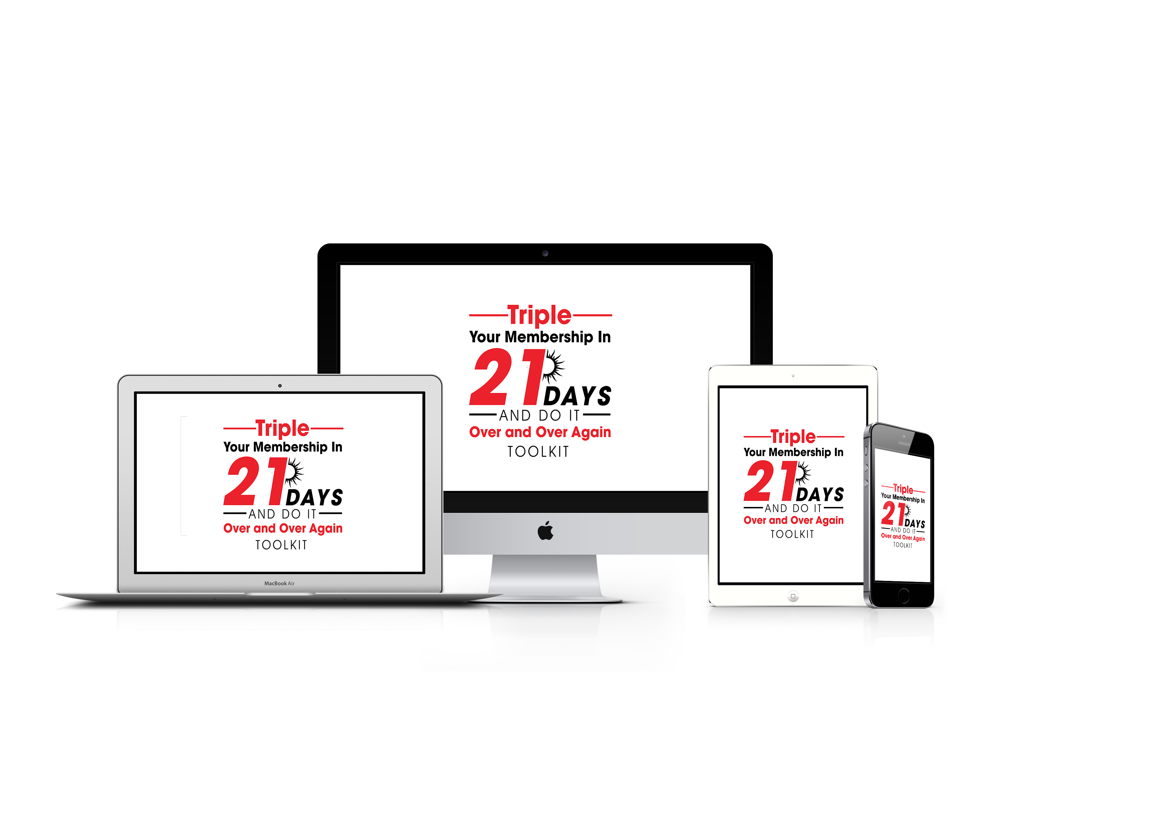

Slide 39

Who This Is Not For
This isn’t magic. The toolkit works, you have to be willing to do what it takes!
If your M-O is to lie, cheat or steal. I’m a man of faith and I want to be proud to send members your way.

Slide 40
what you receive…

Slide 41
Proven Trial Offers that Will Get You More Members
You will get members to stay longer, increasing your retention and multiplying your membership.
Your members will say “WOW” when they experience your membership and will increase their engagement.
A “plug and play” template that you can use to take the guesswork out of taking your members from “sign-up” to fully-engaged.
Value: $297.00

Slide 42
Blueprint To Turn Your Prospects Into New Members
Proven marketing tools to help you identify your best prospects and get them to be members.
Marketing triggers that will compel people to sign up for your membership.
Scripts to handle objections and help people overcome their fear of taking your membership.
Value: $297.00

Slide 43
A Step By Step Process To Go From “Sign-Up” to a Fully-Engaged Member
Creating options for your membership that will automatically create greater value for your members and immediately put more money in your pocket.
Build a “membership ladder” that will give people an opportunity to upgrade their membership or downgrade (and avoid cancelations!)
Multiple ways to get members so you’re never relying on just one way to get members.
Value: $297.00

Slide 44
Bonus #1: TAKE THE GUESSWORK OUT WHAT YOU WILL PROVIDE YOUR MEMBERS MONTH AFTER MONTH
Never worry again if you’re providing “enough” for your members!
Know with confidence that what you’re providing your members is well worth what they pay (if not TEN TIMES more!)
Increased engagement in your membership that will keep your members from quitting.
Value: $497.00

Slide 45
Bonus #2: two free months of Membership Multipliers!
You’ll get me working on your membership business! Imagine having a Membership Expert helping you get more members every month!
You’ll get even more tools every month that will help you keep new members.
You’ll increase your retention and keep people from quitting your membership.
Value: $594.00

Slide 46

You will receive:
1. Proven Trial Offers that Will Get You More Members $297.00
2. Blueprint To Turn Your Prospects Into New Members $297.00
3. A Step By Step Process To Go From “Sign-Up” to a Fully-Engaged Member $297.00
Bonus #1: Taking the Guesswork Out Of What You’ll Provide Your Members $497.00
Bonus #2: Two Free Months of Membership Multipliers $594.00
Total Value: $1,982

Slide 47

You will receive:
1. Proven Trial Offers that Will Get You More Members $297.00
2. Blueprint To Turn Your Prospects Into New Members $297.00
3. A Step By Step Process To Go From “Sign-Up” to a Fully-Engaged Member $297.00
Bonus #1: Taking the Guesswork Out Of What You’ll Provide Your Members $497.00
Bonus #2: Two Free Months of Membership Multipliers $594.00
Total Value: $1,982
Regularly: $997

Slide 48
Today Only
Just $297!
Go to www.MultiplyMyMembership.com

Slide 49

My Personal No Risk, 100% Money Back Guarantee
You have a full 30 Days for whatever reason!
You have up to a full year – just let me know six strategies you implemented and honestly let me know they didn’t work.
If my tools don’t fit your toolbox then I don’t want you to have my tools.
Plus, you get to keep all of the your bonuses and goodies I mail you each month!
Go to www.MultiplyMyMembership.com

Slide 50
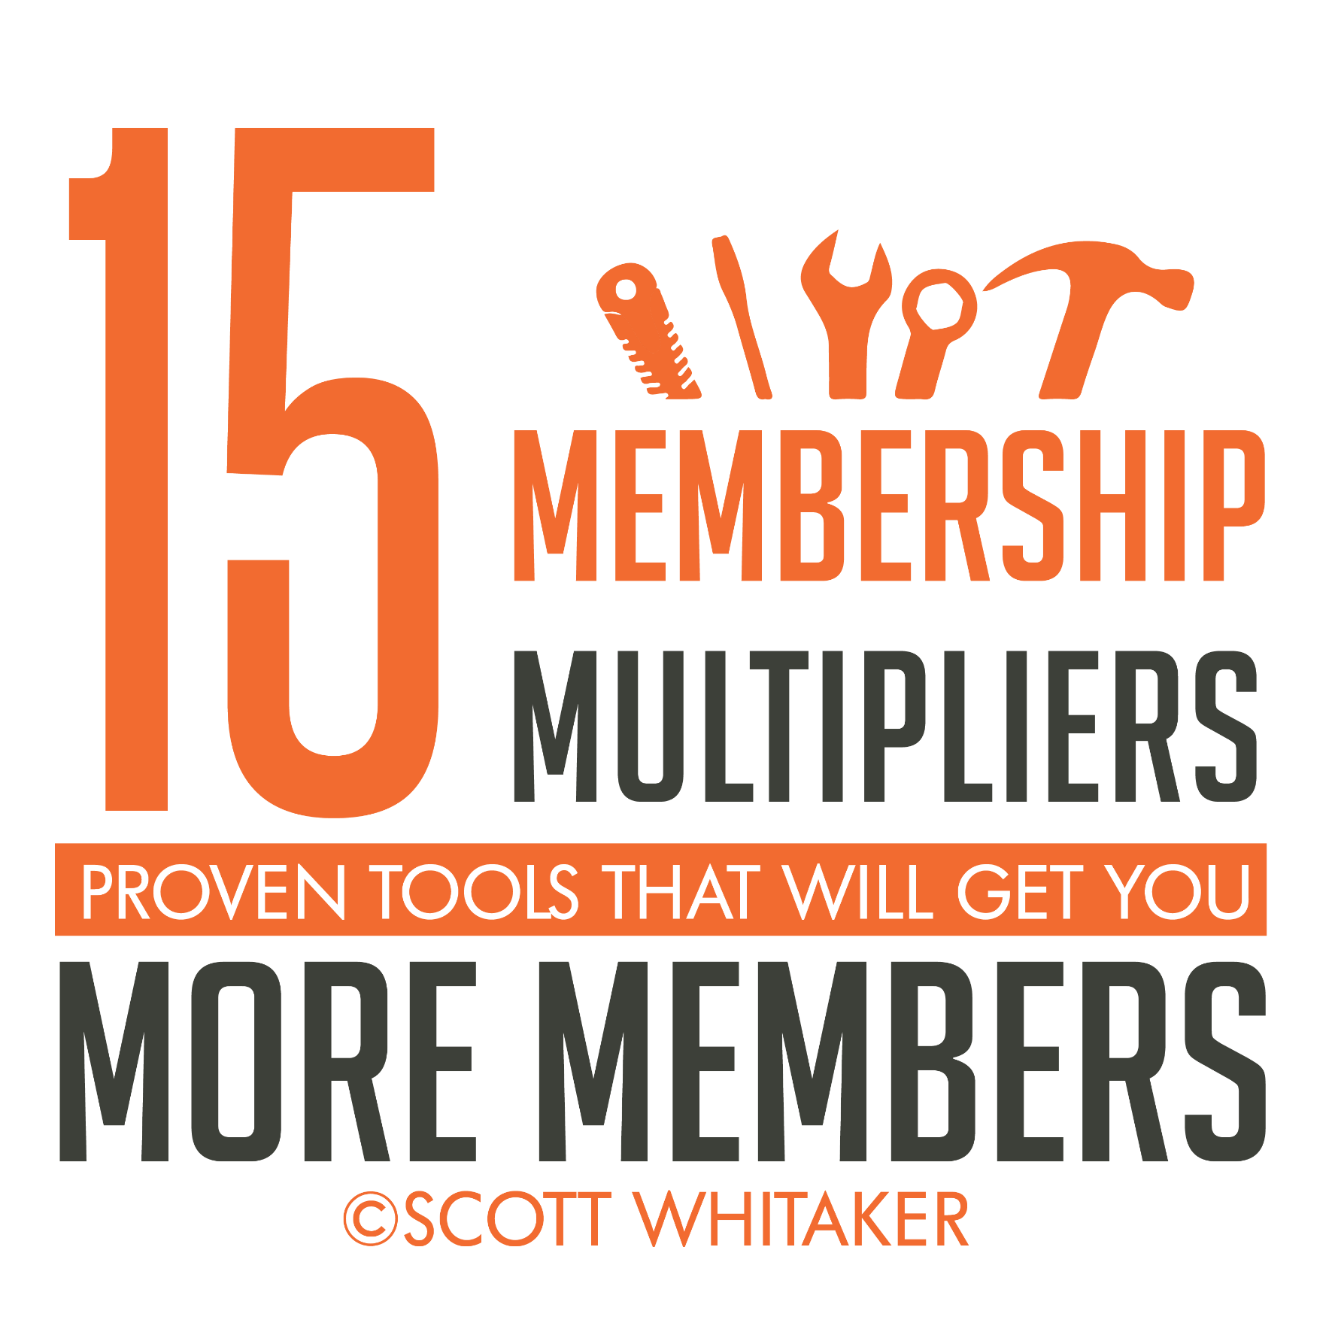
Be one of the first TEN to order now and receive…
Just one of these tools will get you more members – you get 15!
Others have implemented these tools and have multiplied their membership by 57%!
Never have a “stagnant” membership again!
Value: $197.00
Go to www.MultiplyMyMembership.com

Slide 51
Go to www.MultiplyMyMembership.com

Slide 52
You will receive:
1. Proven Trial Offers that Will Get You More Members $297.00
2. Blueprint To Turn Your Prospects Into New Members $297.00
3. A Step By Step Process To Go From “Sign-Up” to a Fully-Engaged Member $297.00
Bonus #1: Taking the Guesswork Out Of What You’ll Provide Your Members $497.00
Bonus #2: Two Free Months of Membership Multipliers $594.00
Total Value: $1,982
Just $297!
Regularly: $997
Go to www.MultiplyMyMembership.com

Slide 53
Go to www.MultiplyMyMembership.com

Slide 54
Remember:
Instead of just adding members you’re going to be able to “MULTIPLY” your membership!
You’ll be able to create a trial offer knowing that people will take it!
You’ll be able to help more people and fulfill your purpose in life.
Go to www.MultiplyMyMembership.com

Slide 55
Go to www.MultiplyMyMembership.com

Slide 56
Go to www.MultiplyMyMembership.com

